Slide 1




LEARNFINITY:
An E-Learning Platform
LEARNFINITY is a cutting-edge e-learning platform developed using Python's Flask framework and MySQL database. The platform provides seamless navigation with a comprehensive homepage featuring login and signup options. It offers tailored experiences for both students and teachers, aiming to revolutionize traditional education methods.

Slide 2
Bhogadi Vidhey
21025A0571

Slide 3

Table of Contents
Introduction
Implementation
Output Images
Get an overview of LEARNFINITY and its key features.
Dive into the technical details of how the platform was developed.
Visual representations of the platform's interface and functionality.
Use Cases
Conclusion
Real-world scenarios and applications of LEARNFINITY.
Summarize the impact and potential of LEARNFINITY.

Slide 4

Introduction to LEARNFINITY
1
Objective
The LEARNFINITY e-learning platform seeks to revolutionize education by seamlessly integrating content creation, communication, and assessment.
2
Technologies Used
Discover the key technologies at the core of LEARNFINITY—Python Flask and MySQL database—and how they enable seamless functionality.

Slide 5

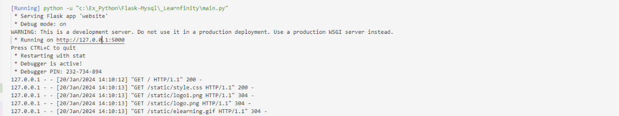
Implementation Details
Step 1 (Open)
Open the terminal and navigate to your project directory.
Step 2 (Execute)
Run the following python command
'''python app.py'''
Step 3 (View Results)
Visit the http://127.0.0.1/5000/ in your web browser.

Slide 6

Contd..
Tasks in Teacher Login:
Tasks in Student Login:
Update Profile
Update Profile
Create Courses
Enroll Courses
Create Assessments
Provide feedback
Evaluate Assessments
Write assignments
Get Feedback
Receive Badge

Slide 7
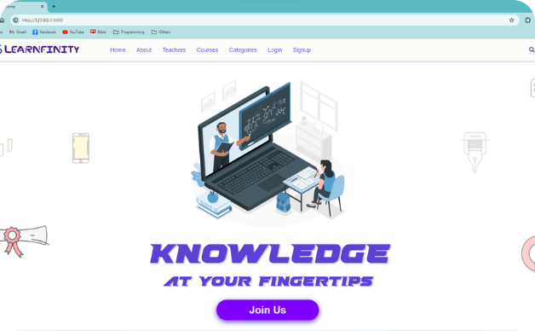
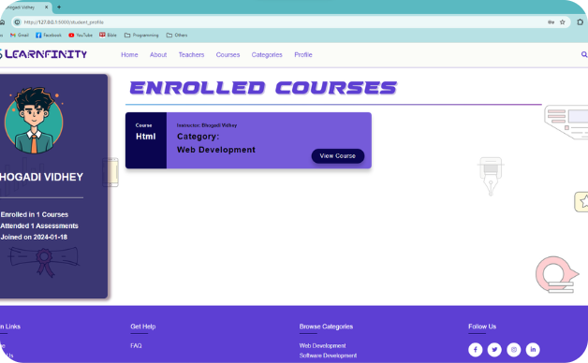
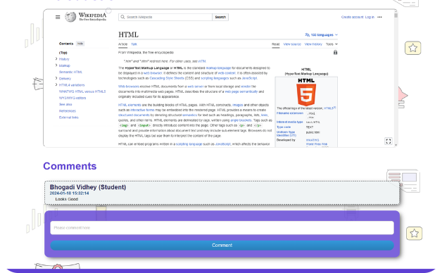
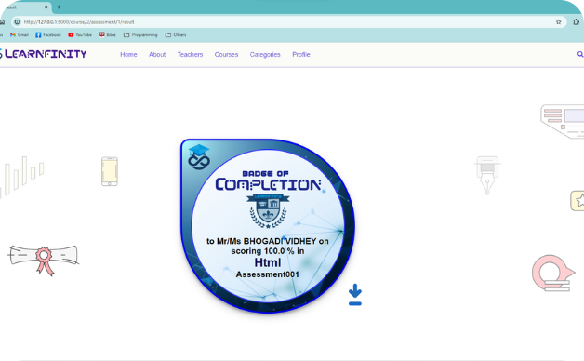
Visualizing Output

Slide 8

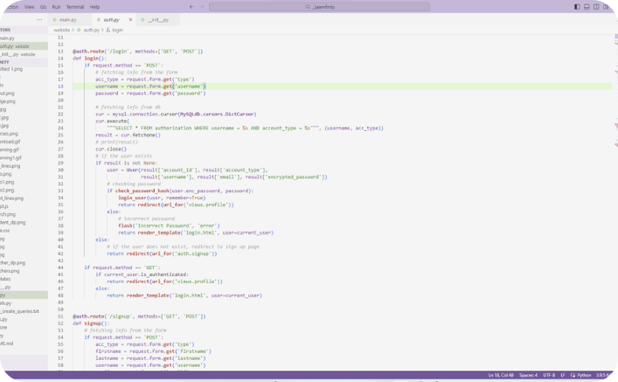
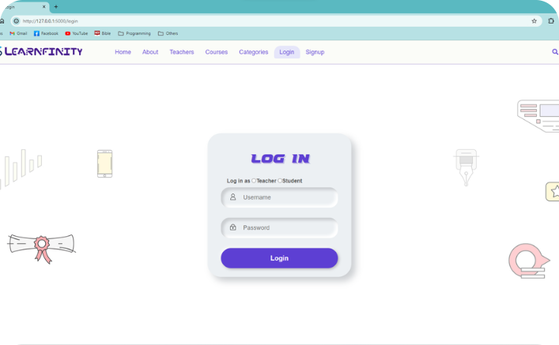
Code Vs Output
Code
Output

Slide 9

Use Cases of LEARNFINITY
1
Teacher Perspective
Understand how LEARNFINITY streamlines course creation and assessment for educators.
2
Student Viewpoint
Explore the intuitive learning journey and interactive assessment process from a student's standpoint.

Slide 10

Conclusion
Impactful Learning
Elevating Skill Assessment
LEARNFINITY's seamless blend of technology and education aims to enhance the learning experience for students and the teaching process for educators.
By incorporating the ability to attempt assessments and gain badges within the platform, LEARNFINITY redefines skill evaluation.
Future Prospects
Explore the potential growth and expansion opportunities enabled by LEARNFINITY's innovative approach.

Slide 11


Thank You for Exploring our
LEARNFINITY
Any Queries ?

